Slide 1
The Education and Healthcare
Spending Project
Tianyi Wang

Slide 2
Background of Datasets
World Bank Datasets
World GDP
World Population
Health Expenditure Per Capita
Government Expenditure on Education
Military Expenditure

Slide 3
My Target Dataset: Education Spending
Year:2006,2007,2008,2009,2010
United States
Japan
Germany
France
United Kingdom
Brazil
Italy
Australia
Mexico
South Africa
**Sort top 10 by total Education Spending
in the year of 2010
Missing Value for Japan In 2009

Slide 4
Dataset: Healthcare Spending
Year:2006,2007,2008,2009,2010
United States
Japan
Germany
France
China
United Kingdom
Italy
Canada
Brazil
Australia
**Sort top 10 countries by total healthcare
spending in 2010

Slide 5
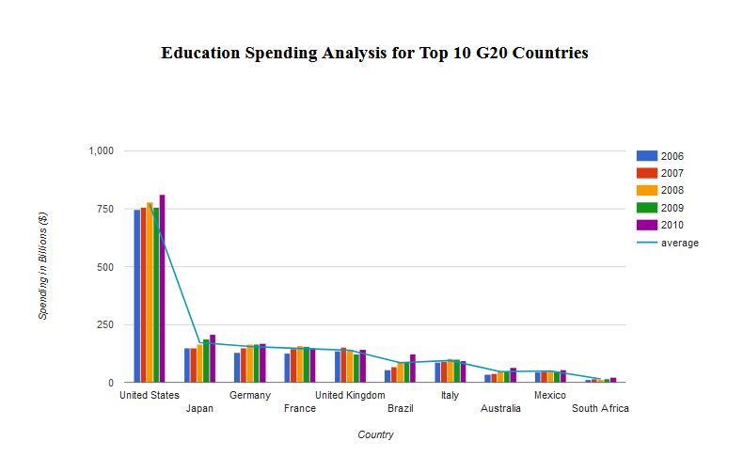

Slide 6
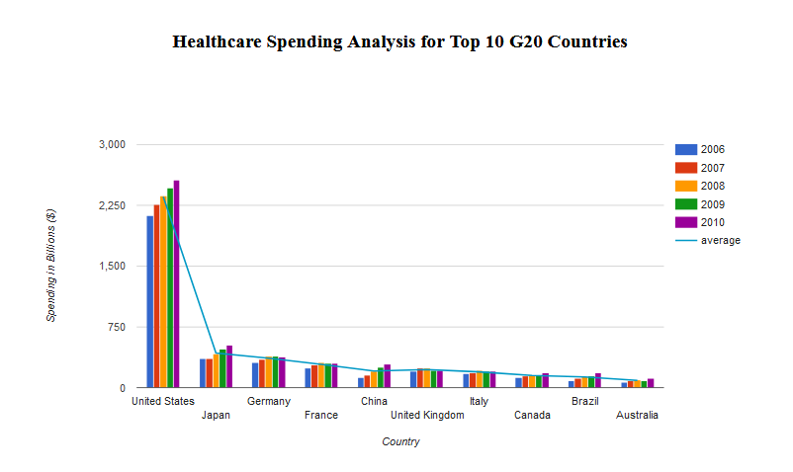

Slide 7
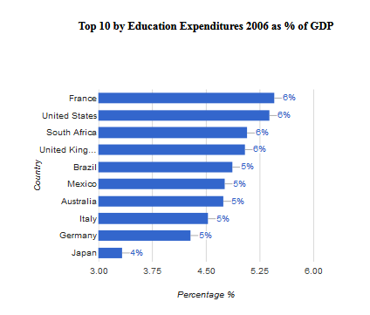
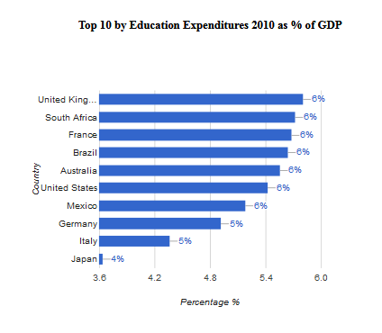
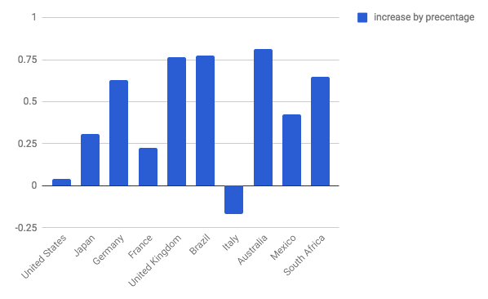

Slide 8
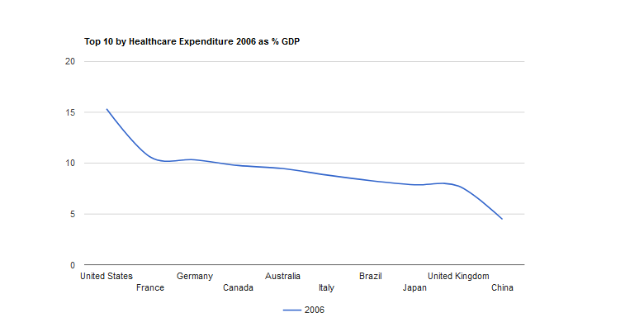
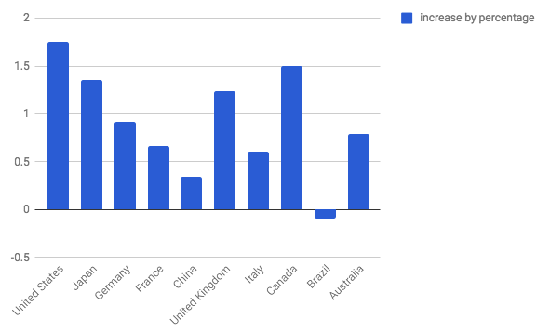
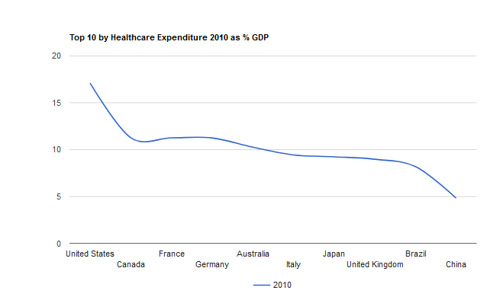

Slide 9
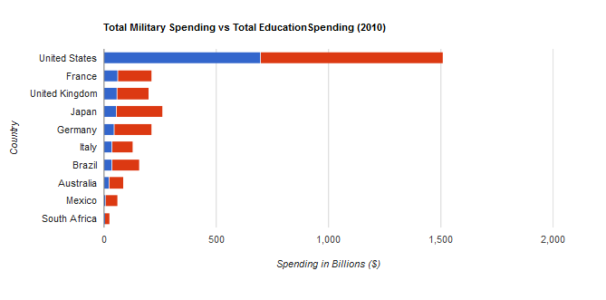
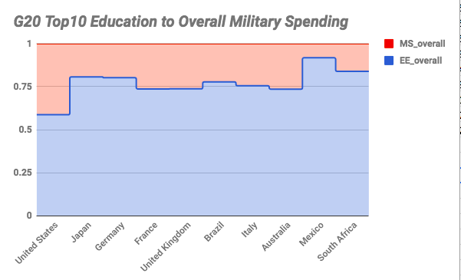

Slide 10
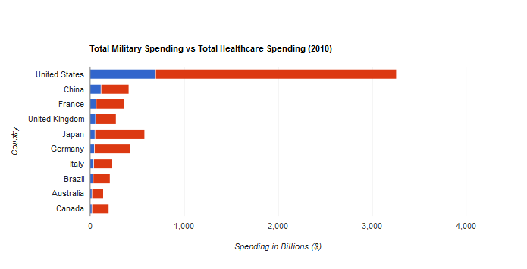
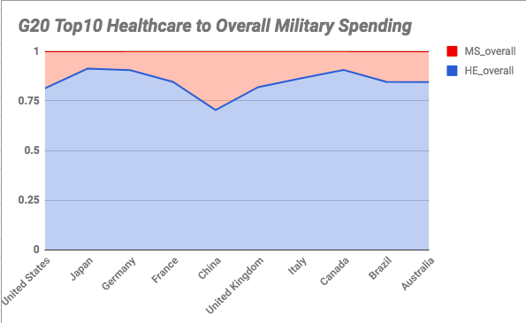

Slide 11
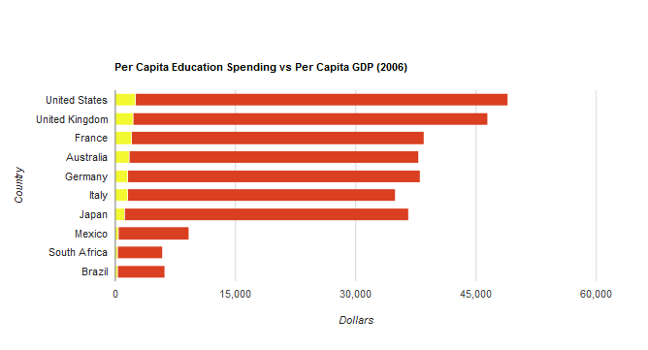
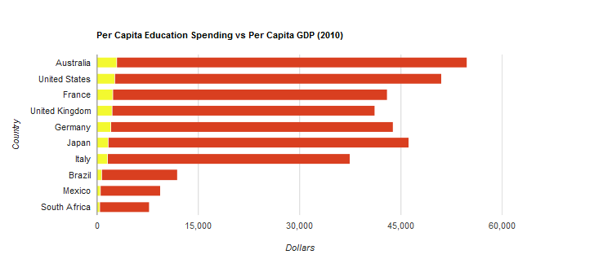

Slide 12
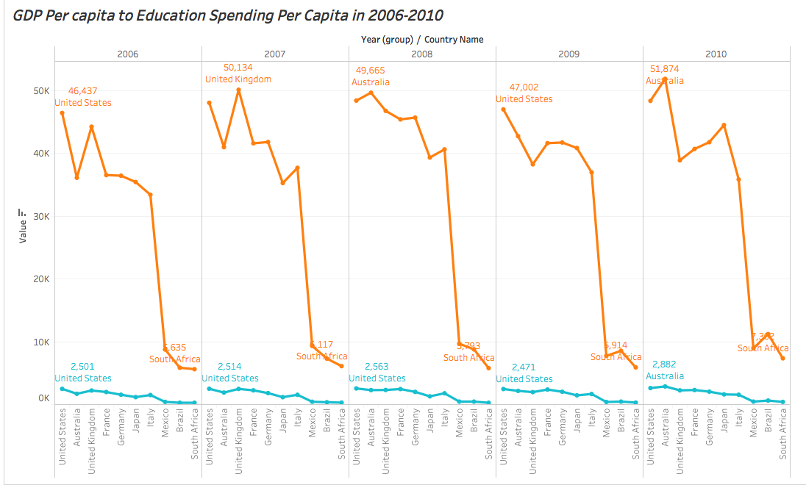

Slide 13
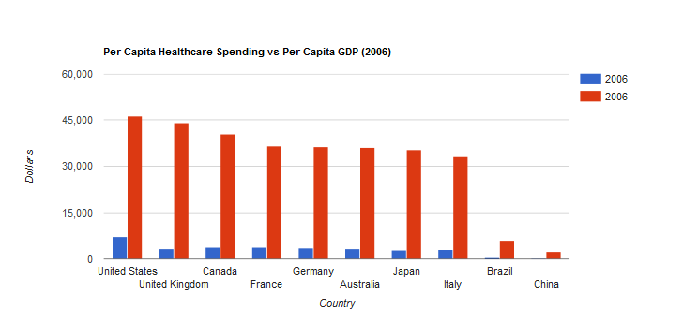
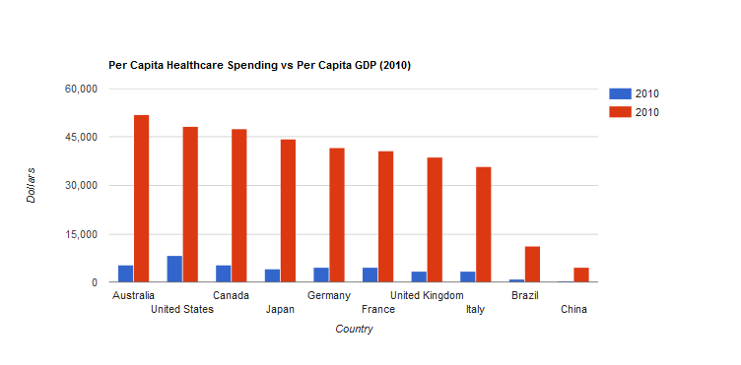

Slide 14
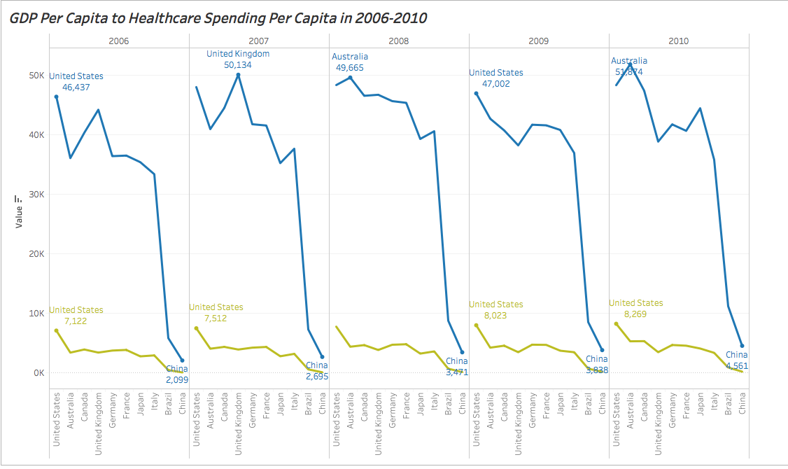

Slide 15
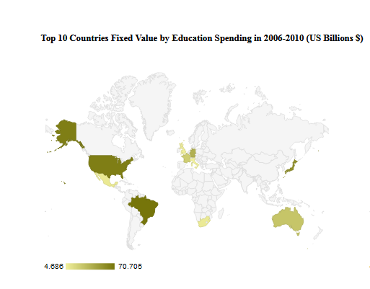

Slide 16
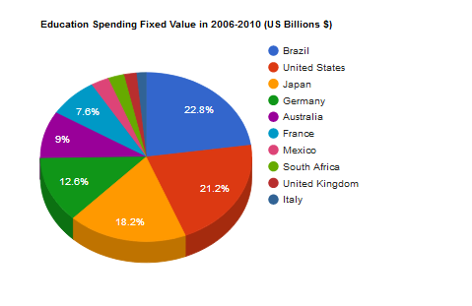
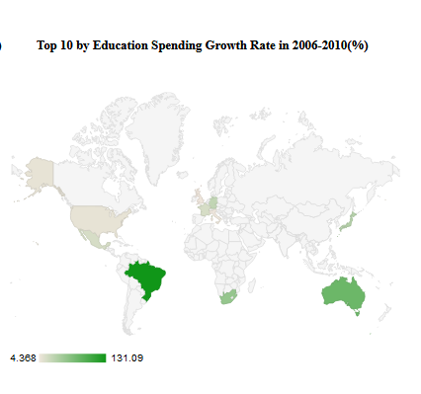

Slide 17
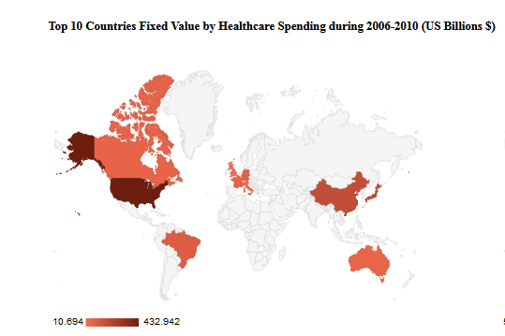

Slide 18
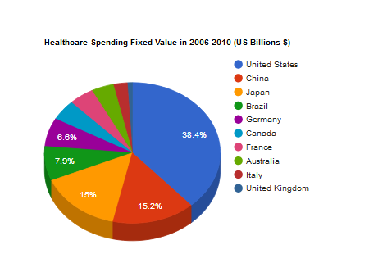
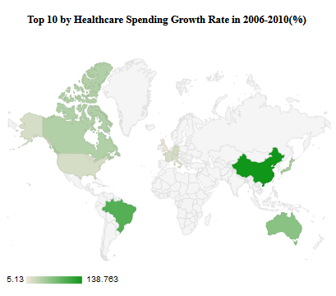

Slide 19
Conclusion
Largest education spending to GDP United States
Largest healthcare spending to GDP United States
Education spending much bigger overall military spending
Healthcare spending much bigger overall military spending
Highest the per person educational spending to the per person GDP
Austrlia (in 2010)
Highest the per person healthcare spending to the per person GDP
United States (in 2010)
the fastest growing country in healthcare: China
the fastest growing country in education: Brazil

Slide 20
Thank you!

